Slide 1
IVOD System Briefing

Slide 2
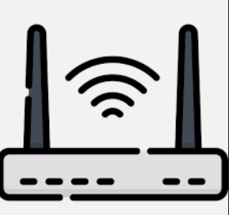


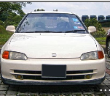



In-vehicle Occupant Detection (IVOD)
Current Setup
router
IVOD server (192.168.70.120)
- 0mq and websocket server
- Web data collection server
- DBscan module
RB Pi (192.168.70.122)
- Radar app
RB Pi (192.168.70.124)
- Radar app
Testing ground
Showroom

Slide 3
In-vehicle Occupant Detection (IVOD)
Issues
The systems are quite standalone and implemented by previous interns
Data visualization on React are fairly incomplete
No spare set of uRAD for us to develop on
Currently held by our interns for data collection

Slide 4
Truncated System Diagram
IVOD Server
Marshal data from lanes to inference engine
Translate commands from workflow to components
Return change in prediction to workflow
Inference Engine
Make predictions based on received data from radars
RPi
&
uRad
Solace
PubSub
Bus
IVOD Server
RPi
&
uRad
Inference Engine
Workflow

Slide 5
Data Flow - 1
E2
RPi
&
uRad
E1
IVOD Server
E3
Inference Engine
Workflow
E4
RPi
&
uRad
Raspi sends raw data to IVOD Server
This data will be tagged in JSON with radar1 and radar2 labels

Slide 6
Data Flow - 2
E2
RPi
&
uRad
E1
IVOD Server
E3
Inference Engine
Workflow
E4
RPi
&
uRad
IVOD server sends combined data stream to inference engine
This data will be tagged in JSON with lane number

Slide 7
Data Flow - 3
E2
RPi
&
uRad
E1
IVOD Server
E3
Inference Engine
Workflow
E4
RPi
&
uRad
Inference Engine returns with the prediction
This data will update the IVOD server with the number of passengers in the car

Slide 8
Data Flow - 4
E2
RPi
&
uRad
E1
IVOD Server
E3
Inference Engine
Workflow
E4
RPi
&
uRad
IVOD server sends update in prediction to workflow
This will only be sent over if there is a change in the number

Slide 9
Context

Slide 10
Testing
IVOD Data Feed (Historical Data)
My effort
Software will be provided to iterate through current datasets
Will pass you the dataset collected so far today
This will be published to the inference engine through Solace PubSub+ Standard

Slide 11
Testing
IVOD Data Feed (Historical Data)
Your effort
Install and setup Solace PubSub+ Standard on a local Docker instance
Create the following queue after installation:
evt/v1/ivod_server/inf_eng/training
Train the inference engine based on the data provided by the simulator

